Slide 1
Micro-Controller
Lab 4 Presentation
By
H R Zitu & Minhazul islam

Slide 2
Problem: Controlling a microcontroller with the PC via UART protocol
Goals
The microcontroller program shall receive the text via the UART0 interface, evaluate the received command and switch the four user LEDs on or off accordingly.
With the switch SW1 it should report to the terminal window, which of the LEDs is currently switched on.

Slide 3
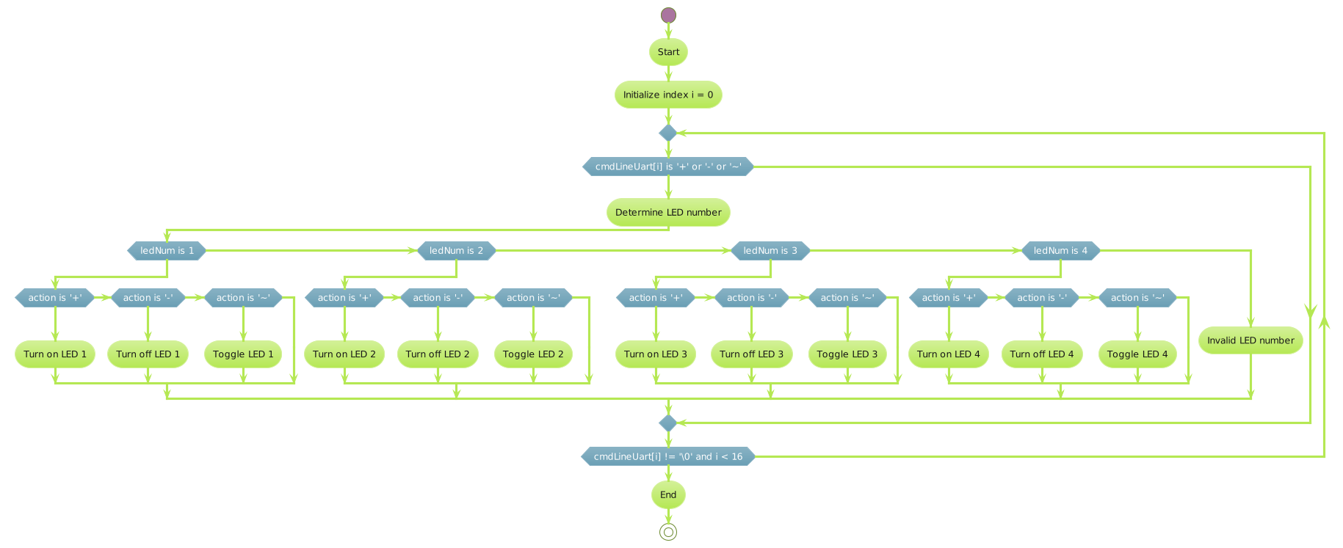
Flow Chart

Slide 4
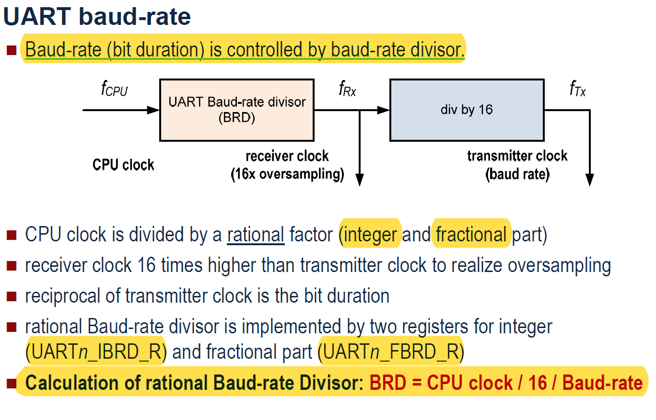
The result
Formulas used
  The counter, my name and Matr. No keeps getting printed to the console on every defined interval.

Slide 5
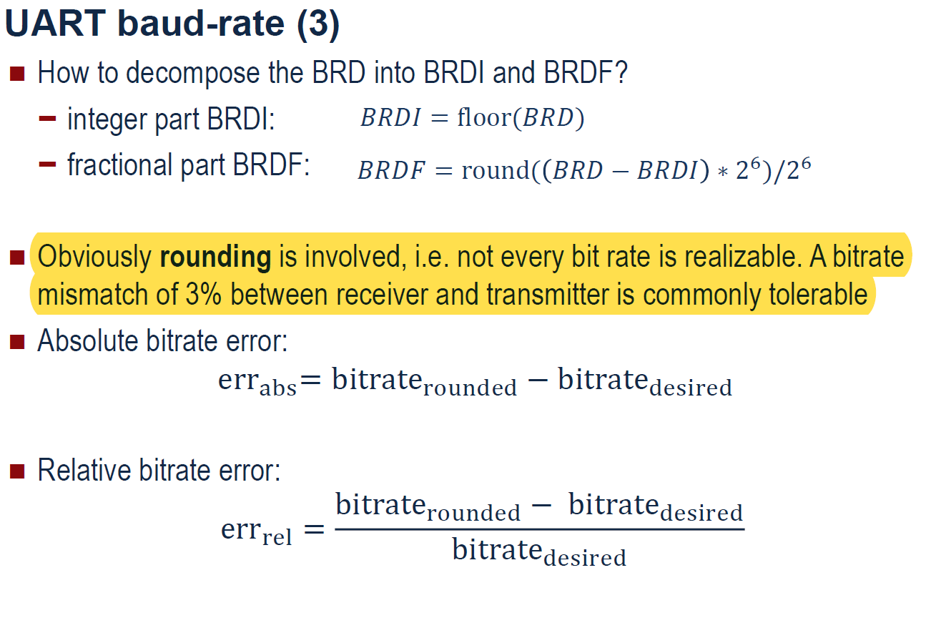
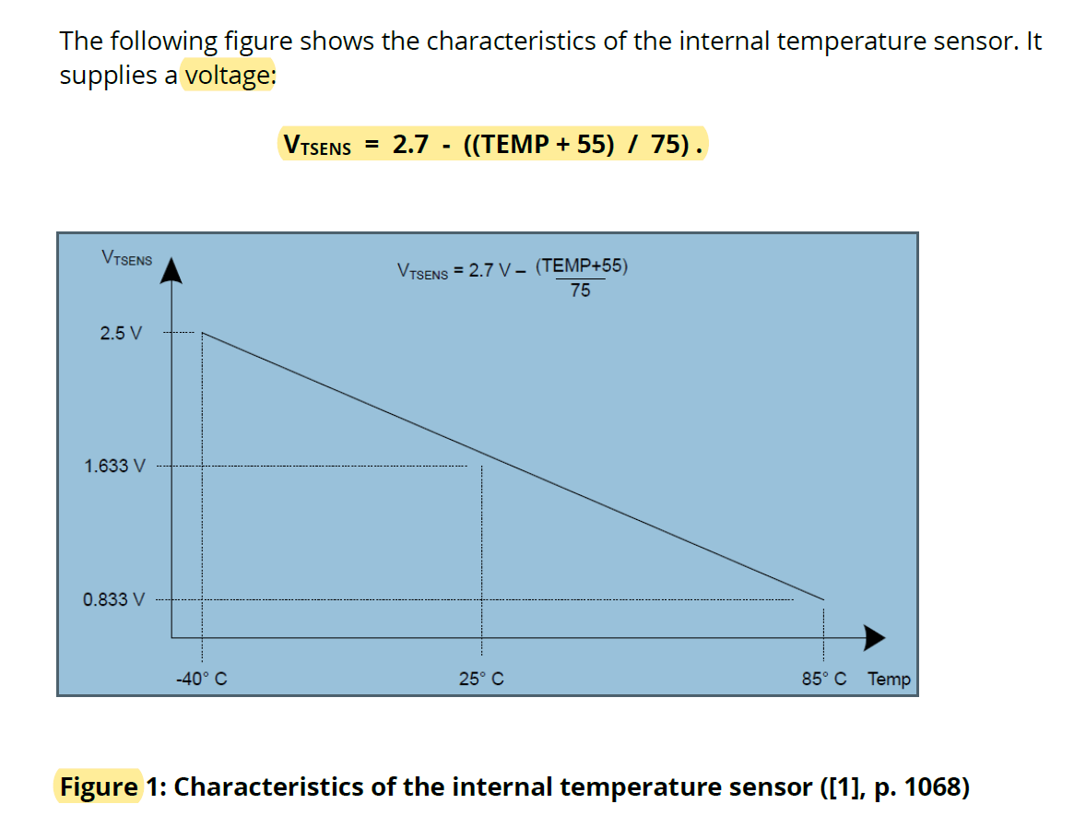
Formulas used

Slide 6
Calculating Error Rate
In the given code, the IBRD is set to 104 and FBRD is set to 11 and the system clock is 16 MHz.
So the actual Baud Rate that has been set in the test program is 16,000,000/(104+11/64)×16 bits/s or approximately 9599.52 bits/s.
The absolute bitrate error is simply the absolute difference between the actual baud rate and the desired baud rate. The formula for absolute bitrate error is:
err_abs = |bitrate_rounded − bitrate_desired|
We calculated the actual baud rate (bitrate_rounded) as approximately 9599.52 bits/s, and the bitrate_desired is 9600 bits/s. The calculation for absolute bitrate error is as follows:
err_abs = |9599.52 − 9600| = |−0.48| ≈ 0.48 bits/s

Slide 7
Calculating Error Rate
The relative bitrate error is the absolute bitrate error divided by the desired bitrate. Another formula for relative bitrate error is:
err_rel = |bitrate_rounded − bitrate_desired| / bitrate_desired
Using the values we have, we get:
err_rel = |9599.52 − 9600| / 9600
so, err_rel = 0.48 / 9600 ≈ 0.005%
So, the absolute error in the baud rate is 0.48 bits/s, and the relative error is 0.005%, indicating a very small deviation from the desired baud rate.

Slide 8
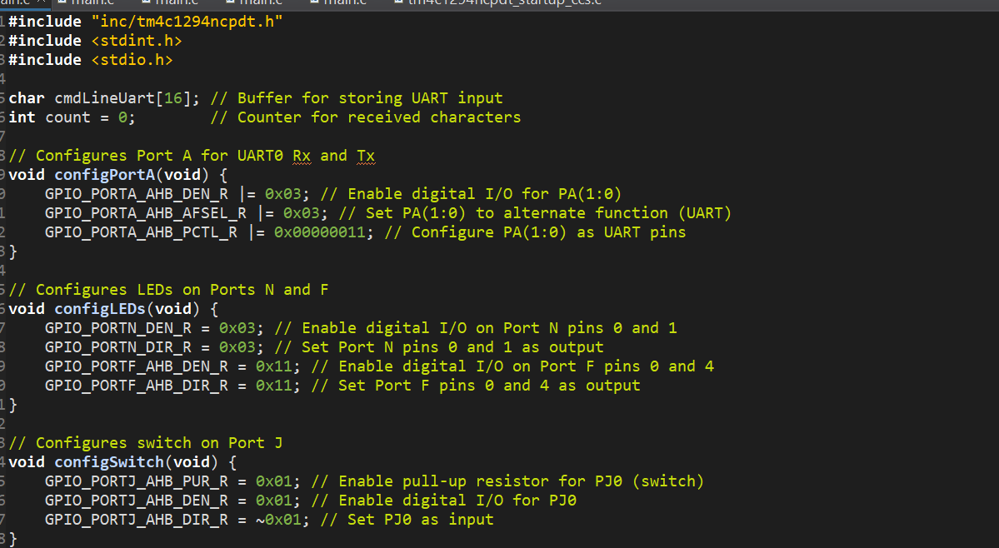
Source code

Slide 9
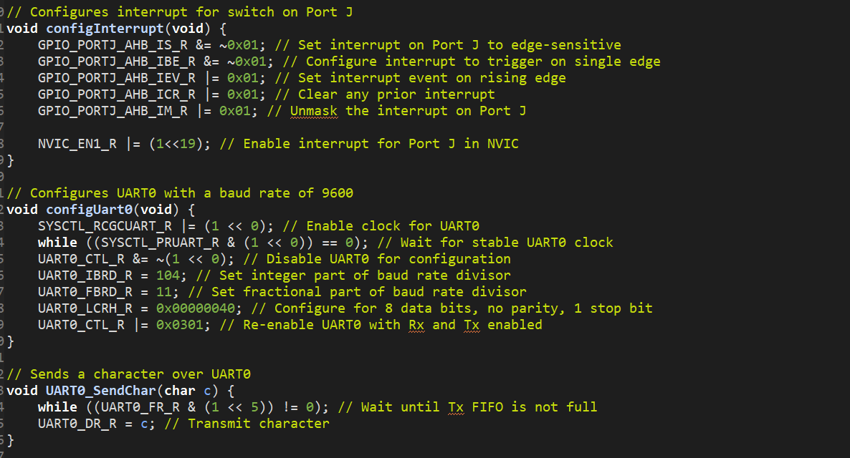
Source code

Slide 10
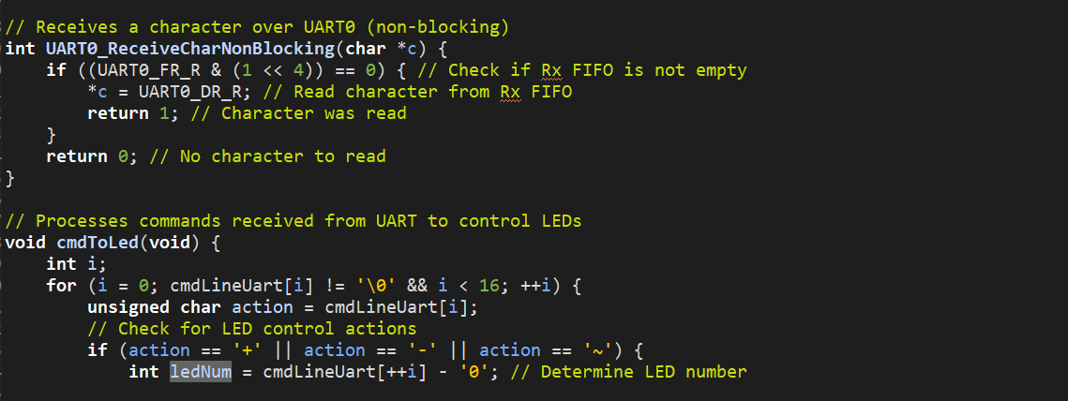
Source code

Slide 11
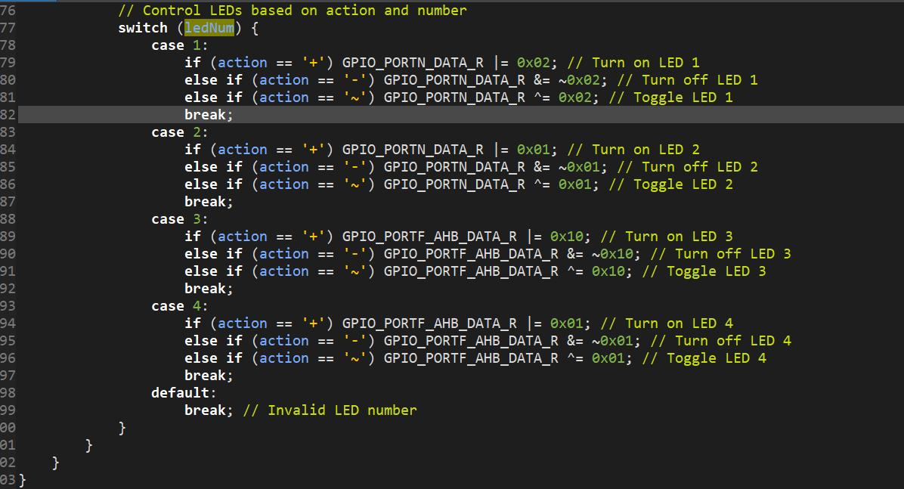
Testing The Prototype
Source code

Slide 12
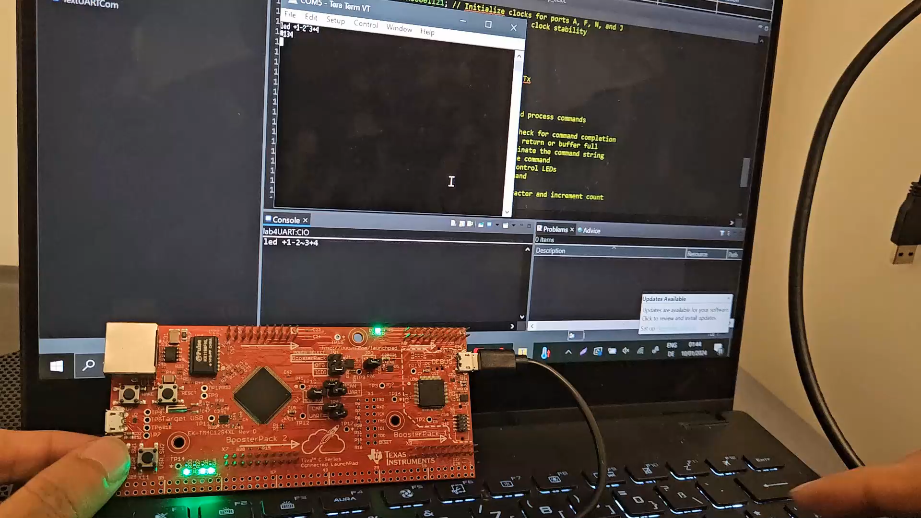
The result

Slide 13
Final Observation
This code is designed to run indefinitely, continuously reading commands from UART0 and controlling LEDs on the TIVA TM4C1294XL Evaluation Board based on these commands. The switch on Port J is configured to generate an interrupt, and the state of the LEDs can be queried and transmitted back to the console.
All these tasks was completed successfully with expected output.

